Slide 1
TEACHING PRESANTION “ALIGNMENT”
CIT 230
Brother Blaine Robertson
Prepared by Besmir Gjoni
September 27 , 2016

Slide 2
What is Alignment ?
Alignment is arrangement in a straight line or in correct relative positions. So you make the text and graphics line up

Slide 3
Benefits of Good Alignment
Proper design ,make the web more appealing
It is easy for user to scan over a page
Help the user to have easier reading experience
User does not get confused

Slide 4
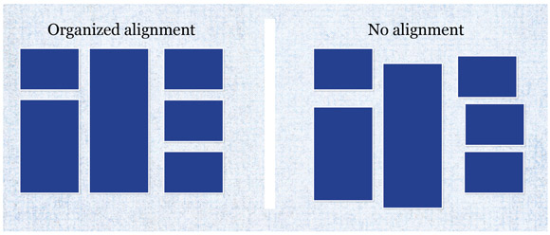

Slide 5
There Are 4 Options for Text Alignment
Left
Right
Center
Justified

Slide 6
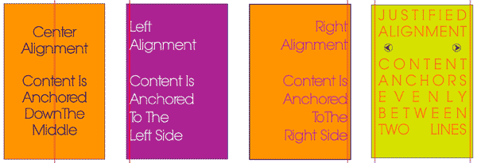

Slide 7
General Rules of Aligning a Text
Align to the left
Unless you are designing in a language that is read from right to left , e.g. Arabic then you align on the right

Slide 8
Right Text Alignment Can Offset Your Design
Right alignment rules
We use only with small amount of text and try to keep the design balanced
Everything that is on the right should match on the cap, base and everything that is on the left

Slide 9
Centering
Should be in moderation
Is great for header in web design
Works better with small portion of text

Slide 10
The westerns read from left to right so usually we find the text in the left side of a web Small amount of text can work well in the center

Slide 11
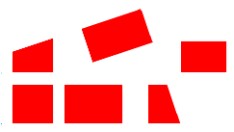
We have 2 kind of alignment for figures and objects
Edge alignment
Edge alignment

Slide 12
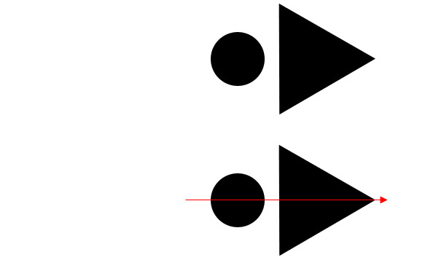
Center Alignment

Slide 13
How do we align our content?
One way is by using grid .
Grid is structure that is made up of columns and rows to help us structure our content

Slide 14
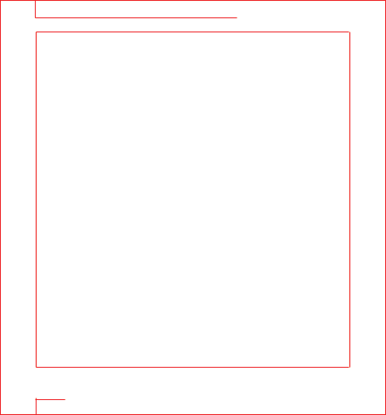
We Have 4 Types of Grid
Manuscript ,
Has only one column

Slide 15
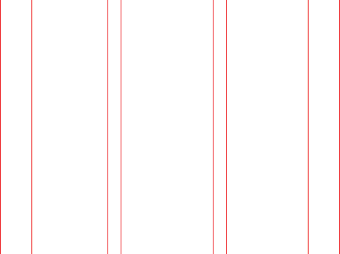
Column
Is made of columns

Slide 16
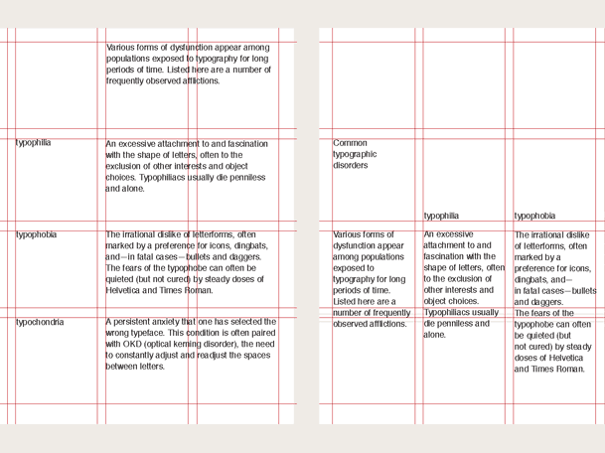
Modular
It is used to separate information , like schedule

Slide 17
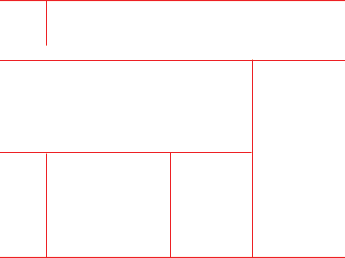
Hierarchical
It is used to have different content to go in it

Slide 18
But grids do restrict us , and there is not much creativity!!!
We can use different grids in top of each other .we can also align our content without a grid first and then we use grid

Slide 19
Topography
Topography and alignment work together.
Topography is the most important aspect of design.
Topography is art of applying designing element to letters and text
Style and Size are among most important element
because of readability and legibility, are at the top of the list of functions of topography

Slide 20
Effects of bad topography
Difficult to read
It is not discernable
Creates confusion in user

Slide 21
We should choose carefully text style that we use ?
Kerning , space between letters
Tracking , space between words

Slide 22
How does the worst website look like ?

Slide 23
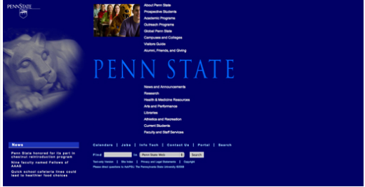

Slide 24
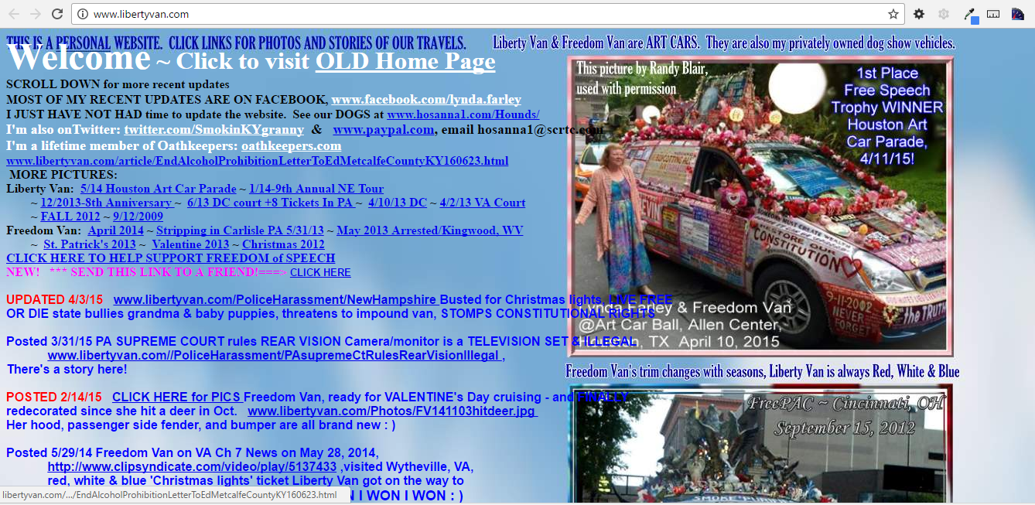

Slide 25
How do some of the best websites look like ?

Slide 26
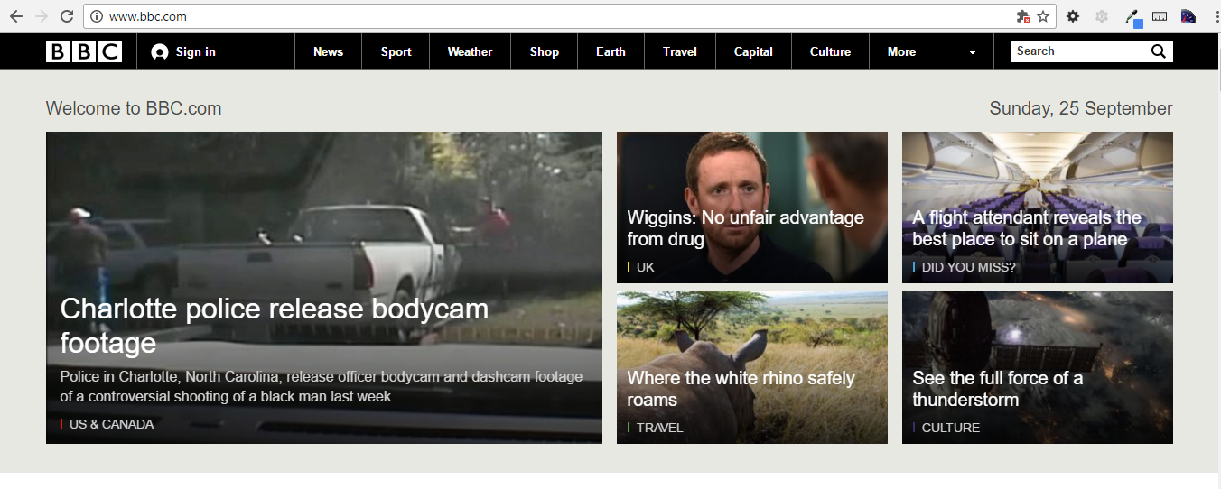

Slide 27
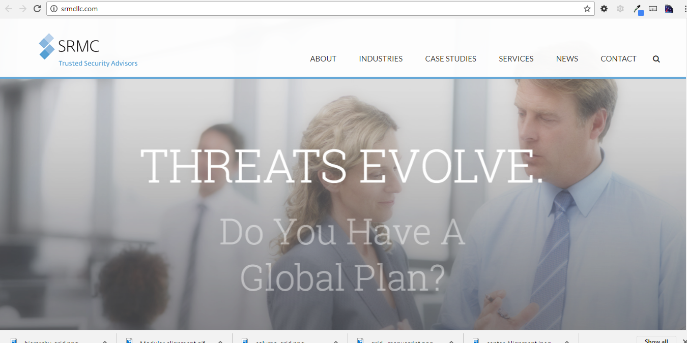

Slide 28
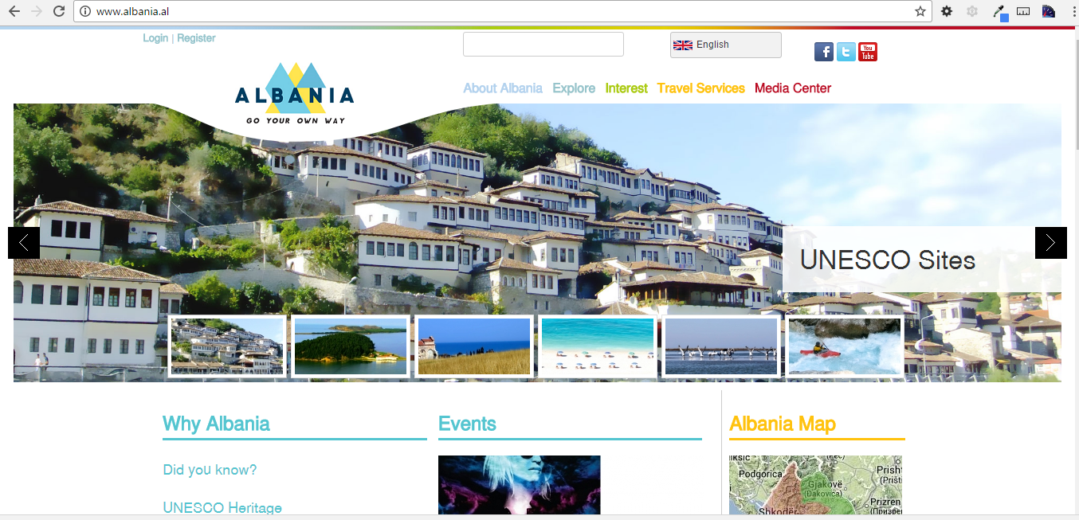

Slide 29
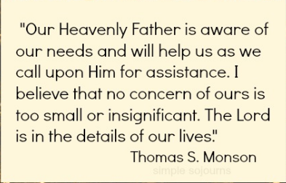
Thank you for your attention

